Slide 1
Do you get this? (You will)

Slide 2
CST8182 Networking Fundamentals
Computer Systems Technician Program

Slide 3
Introduction

Slide 4
Class Rep Election
Email me before Monday, Sept. 8, 2025 @11:59PM if you wish to put yourself forward as a candidate.
Each candidate will get 2 minutes to introduce themselves to the next theory class.

Slide 5
CST8182 – Networking Fundamentals
Passing this course is simple, but not easy…
Show up for all of your classes.
Be truly present in class.
Don’t play games.
Turn off all social media.
If you’re not using it for notes, put your laptop (and phone) away.
Don’t “multi-task” in class. It really doesn't work.
Once you are in the class, you cannot leave unless for washroom!
Be respectful to the professor and other students!

Slide 6
CST8182 – Networking Fundamentals
Passing this course is simple, but not easy…
Be on time for your lab classes. Explanations are given at the start.
Be PREPARED for your lab classes.
Bottom line. Just do the work without trying to find shortcuts.

Slide 7
CST8182 – Networking Fundamentals
Starts off fairly easy, but gets harder.
Don’t allow yourself to get complacent.
(Break Week)

Slide 8
How to email a question
Really? Why are you telling me how to send an email?
Because we get some really bad emails!
You want to get a good answer, as fast as possible.
You don’t want your prof’s to reply to be something like:
“Send me a screenshot so I know what you’re taking about”
“Send me the file that you’re working on so I can have a look.”
“Your question is too vague, please be more specific.”

Slide 9
How to email a question
USE YOUR COLLEGE EMAIL ONLY
Be sure you are emailing the correct professor.
We get emails that were intended for other profs all the time. It causes delays in getting the answers you’re looking for.
Typical reply: “Are you sure you sent this to the right prof?”
Good questions get good answers!

Slide 10
How to email a question
Set up an email signature! (Part of your Week One Tasks)
It should look similar to this:
Jeje Jap (japj@algonquinlive.com)
(She/her) *Optional
Computers Systems Technician – Level 1
Student Number: 020 123 456
CST8182-010, 012
CST8207-010, 011
CST8202-010, 013
MAT8002-020
ENL1813-017
Shows all of your courses and section numbers.
Good questions get good answers!

Slide 11
How to email a question
Use a subject that is relevant & limit the email to the subject.
Separate and number your questions. (If there is more than 1 topic)
Describe the attachments. (Don’t send empty emails)
Keep the original text in your replies.
Good questions get good answers!

Slide 12
How to email a question
Don’t use a reply to ask a question that isn’t relevant to the original email (See the 1st point)
For example, Fariba sends an email with the subject “Lab 1 reminder.” Replies to this email should only be about the Lab 1 reminder.
Good questions get good answers!

Slide 13
How to email a question
ALWAYS include screenshots and any files that you're working on. (What you think is obvious might not be.)
Be specific:
“I’m stuck on step 3.2 of lab 2. I don’t understand what you mean by ______. I understand it as _______.”
Don’t be generic and don’t assume I’ll know what you mean:
“I’m stuck on the quiz” or “I can’t find the quiz” explains nothing.
Good questions get good answers!

Slide 14
How to email a question
Theory related emails
Must be sent to
Fariba
Lab related emails
Must be sent to
Lab Instructor

Slide 15
How to email a question
ALWAYS include screenshots and any files that you're working on.
Good questions get good answers!

Slide 16
How to email a question
Please follow up with a quick email if you solved your problem!
Just do a reply all to your original email that says something like “I solved it, no need to respond.”
If you have any questions regarding labs, this should be asked during the lab time. It’s much more convenient both for you and your lab instructor.

Slide 17
WARNING
Discord can be helpful, but also often spreads wrong information.
People often post the WRONG answers (in general and for assignments)
On that note…

Slide 18
Helping others
Posting answers, solutions, etc. for assignments on places such as a Discord is not helping anyone pass the course.
It’s more likely to help them fail the course! They won’t be able to pass the exams because they didn't do the work.
It’s also academic dishonesty. (Cheating)

Slide 19
Helping others
Working with others in a collaborative fashion is okay, if you do it right.
Help each other learn by pointing them in the right direction rather than just giving out answers.
Take the time to show someone WHY an answer is the answer.
Take the time to help someone work out the answer.
It’s also fair to just tell someone to do the reading, read the lab, pay attention in theory…

Slide 20
Do you want to pass?
READ THE BOOK!!!
This is a THEORY course
The majority of the marks come from THEORY tests.
The labs help reinforce some of the theory.
Almost everyone gets nearly perfect marks for the labs.
Almost everyone who fails the course has very good lab marks.

Slide 21
This is a THEORY course
This is a tough course.
It takes a lot of work.
It is not possible to pass this course by just showing up.
Do you want to pass?
READ THE BOOK!!!

Slide 22
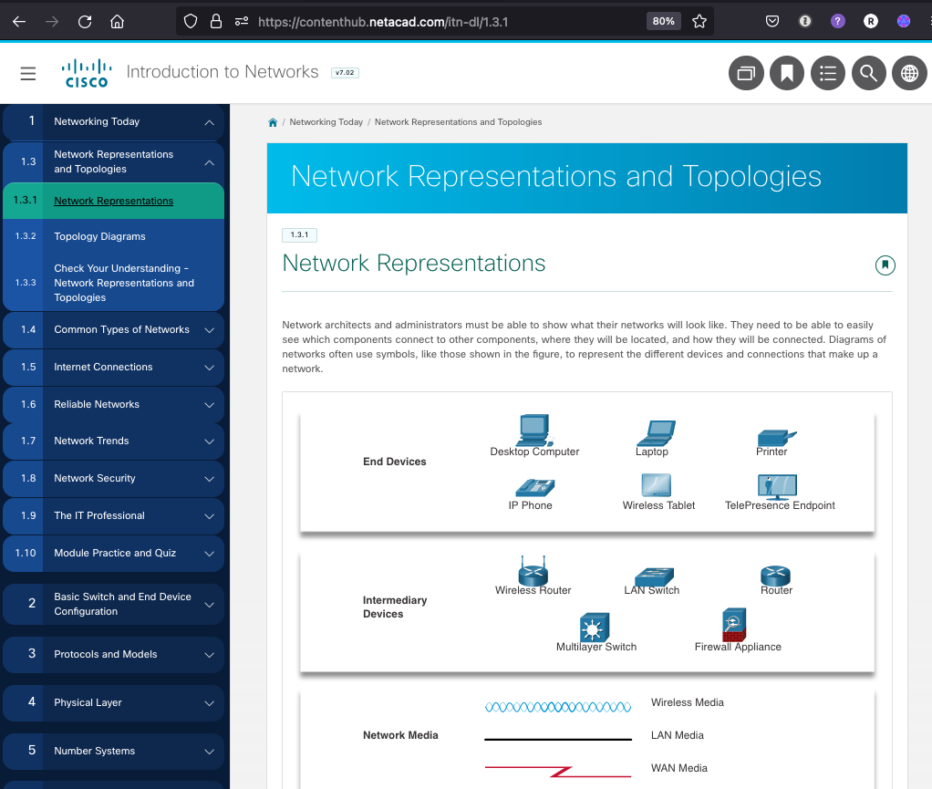
The Reading is CRUCIAL
It’s the hardest part of the course
Those who don’t take it seriously fail the course.
At LEAST 3 hours every week just reading. (Many spend more than 3 hours per week.)
It gets harder as we go.
ELIMINATE distractions while you do it.
Take notes!

Slide 23
Do The Work
Reading
Studying
Pre-labs
Labs
Post-labs
Quizzes
Exams
Everything we are asking you to do has a single goal… Helping you prepare for the next step.
Commonly heard in level 2: “I don’t understand how so many people failed level 1. They just needed to do what you told them to do.”

Slide 24
Do The Work
Your prof’s don’t do things without a reason.
If I take the time to write an email, I thought it was important enough to use my time to write it.
If I take the time to make a video, I thought it was important enough to take my time to make it.

Slide 25

There is no “easy” way through this course.
I’d tell you if there was!
It takes at least 10 hours per week! (Yes, it really does.)

Slide 26
Who passes this course
The people who try to understand and learn, rather than “chasing grades.”
What’s the difference between doing the work and trying to learn vs. chasing grades?
One helps you get some marks.
The other helps you to build your knowledge and also pass the course.
If you discover that you need to cheat or copy others in level 1, you are in the wrong program.
If you can’t commit to spending the required amount of time, you are in the wrong program.

Slide 27
Assumptions
Never make an assumption that could result in a negative consequence.
Examples:
You’re not sure if you need to attend a class: Assume that you need to attend until you know for sure that you don’t.
You’re not sure if you need to submit something: Assume that you need to submit it until you know for sure that you don’t.
Ask your prof, not Discord!

Slide 28
Who Doesn’t Pass?
Those who sit at the back of the room playing video games.
Those who don’t do the reading.
Those who don’t read their email every day
Those who prioritize based on only what has the most marks
Is a lab that is worth 1% truly only worth 1%?
What about when that topic shows up on an exam later?
Those who procrastinate. (Procrastinating is deadly in this course.)

Slide 29
Don’t let the perfect be the enemy of the good.
Trying to get PERFECT marks on everything can be a bad thing.
90% is an A+
Diminishing returns:
A student spends two hours on an assignment worth 5% and is at 95%.
They then spend another two hours trying to get the last 5%, rather than moving on to something else.

Slide 30
How do you EARN your passing grade?
Practical (45%)
Theory (55%)
Labs Activities, quizzes: 15%
SBA #1: 15%
(How will you do if you just “jump through the hoops” when you do the labs?)
SBA #2: 15%
Midterm 1: 25%
1st half of semester
Final exam: 30%
2nd half of semester.

Slide 31
How do you EARN your passing grade?
To be eligible to pass the course, you must have at least 50% of the marks from the practical portion of the course. AND
To be eligible to pass the course, you must have at least 50% of the marks form the theory portion of the course.
NOTE: Almost everyone gets excellent marks on the SBAs. All you need to do is practice. People rarely fail the course based on the practical portion.

Slide 32
How do you EARN your passing grade?
There are no make-up SBAs or extra assignments.
There are no make-up midterms or extra assignments.

Slide 33
Why are individual labs worth just 1% each?
Lab assignments are used to help you learn.
They are not used to evaluate what you’ve learned.
SBAs and exams evaluate what you’ve learned.
A lab may only be weighted at about 1%, but not understanding the concepts will cost way more than 1% on the exams & SBAs.
Skipping a lab because you have an exam in another course is a bad idea. It could be the difference between passing and failing the exam.

Slide 34
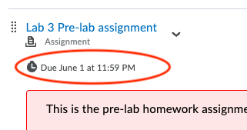
Labs
All lab assignments will be posted on Brightspace with instructions. Do NOT wait until the day of your lab class before checking Brightspace.
Many labs will have homework. (Pay attention to due dates)
Some may also be accompanied by video demonstrations. (Watch them!.. In their entirety!!!)

Slide 35
Labs
Lab attendance is mandatory for some weeks and optional for some other weeks (This will be announced every week!). (You must attend your own lab class)
Missing more than 2 Mandatory lab classes will result in failing the course.
This is regardless of the reason.
This does not mean you can skip a lab if you’re not sick.
People have failed because they skipped a couple of labs and then missed a 3rd because they were really sick or had an accident.

Slide 36
BE ON TIME
Being late is disruptive.
Being late is disrespectful to the rest of the class.
Being late is disrespectful to the professor.
On time means at least 5 minutes BEFORE the class is scheduled to start.
Example: If a class starts at 9:00am on time means 8:55am

Slide 37
No Extensions… usually
Once someone is behind, it is VERY difficult to catch up.
There is no “Catch-up week”
There are no extensions for the midterms or the SBAs
These are major assessments, and the college Deferred Evaluation policy applies. (Proper documentation is required.)

Slide 38
Make-up tests
Must be done in the Test Center
You need my permission.
You need a good reason.
There is a fee for this. ($30?)

Slide 39
Due dates
Use a calendar to plan your time.
You are responsible for keeping track of due dates and completing your work on time.
Due dates are not suggestions.

Slide 40
Multitasking
Reading a book while riding the bus to school is effective multitasking. The riding the bus part takes very little thought.
Working on an assignment for one class while in theory for another class is NOT effective multitasking. It doesn’t work.

Slide 41
Course Resources
Important Documents
Confirm you have access to:
Brightspace
Cisco Netacad
ACSIS
Email
Weekly schedule (on Brightspace)
Consult this document often!
Course Assessment breakdown

Slide 42
Course Timetable
Lectures – 3 hours/week
Labs – 2 hours/week (You need to check your timetable at ACSIS)

Slide 43
About CST 8182
layers of communications in data networks based on the TCP/IP protocol suite
network protocols (Ethernet, ARP,…)
IPv4 addressing scheme
Building a small network using routers, switches, and end devices
Testing network connectivity

Slide 44
What else do you need to know?
Take notes in labs
Record ALL commands and what they do in a lab journal
Use a dedicated lab book. (It’s in your kit.)
The biggest lie you can tell yourself is “I don’t need to write that down. I’ll remember it.”
People who don’t take notes struggle – A LOT! (The lab prof will only tell you a command the 1st time.)

Slide 45
Check your email
Every day, more than once.
Read all the words!
You will get a lot of email, but it’s nothing compared to what you’ll get in when working in this industry.
Not checking your email is a choice.
Not reading instructions is also a choice.
You have the right to make these choices but do it knowing that you are also choosing to accept the consequences of those choices.

Slide 46
Check your email
“I didn't see the email” will never be accepted as an excuse.
Most emails are sent through Brightspace
They all look the same, so you have to read them
Read. Don’t “skim”

Slide 47
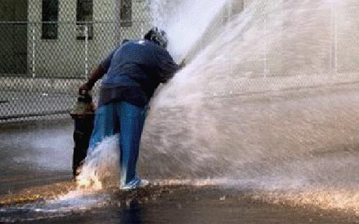
A LOT of Information!
Plan your time
Keep up at all costs
Feeling lost for the 1st couple of weeks is normal.
Keep working.
Keep studying.
Ask questions.
It will start to make sense if you work at it.
Don’t compare yourself with others.

Slide 48
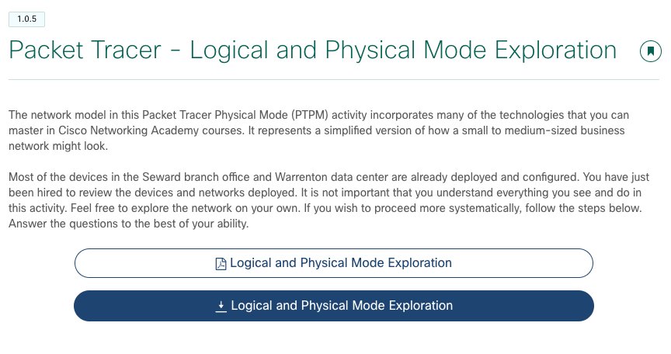
Netacad Packet Tracer Activity
It’s in Module 1
It’s worth doing.
We don’t use the physical workspace and it may not work well in the activity. You can just skip that part.

Slide 49
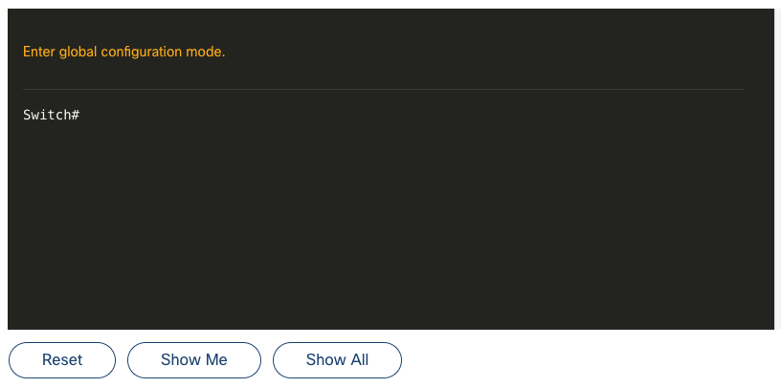
Netacad Activities
Doing them is 100% optional.
They’re not submitted or marked.
You should absolutely do the ones in module 2. (Syntax checkers)

Slide 50
Worst things you can do
Failing to communicate.
Assuming you’ve already failed the course and just giving up.
Talk to your professors!!!

Slide 51
Netacad Problems?
Clearing history usually solves problems with Netacad.
Suggestion: Use a second browser exclusively for Netacad & Brightspace.
Netacad & Brightspace seem to work best with Firefox & Chrome.

Slide 52
Get started now
Login to netacad.com
Reading Module 1 and 2
Download Packet Tracer 8.2.2
Download and Install Wireshark
Be finished module 2 by the end of week 2

